Slide 1

Analysis 1: Foundations of Modeling Lesson 1.2: Algorithms and Python
Analysis Team, 2020/2021

Slide 2
Introduction to algorithms

Slide 3
Overview of this lesson: Introduction to computer science
Learning objectives:
Understand what is an algorithm and how to read it from and write it to a flowchart.
Get familiar with Python and a Python IDE (Pyzo or Spyder).
Output text and evaluate simple arithmetic expressions in a console and using the print command.
At the end of the lesson a student should be able to:
Read and understand an algorithm from a given flowchart, and
Implement it in Python.

Slide 4
Introduction to algorithms
In order to work, computers need programs (software).
Using programming software we can create any kind of application.
Some text editors with compilers / interpreters.
Complex IDE (integrated development environment)
Writing computer program means telling the computer STEP-BY-STEP EXACTLY what it needs to do.
The computer then executes these steps to accomplish the goal.
To understand the program and how it works we have to understand ALGORITHMS.

Slide 5
Algorithm
Algorithm definition (Oxford dictionary):
“a process or set of rules to be followed in calculations or other problem-solving operations, especially by a computer.”
An algorithm is:
A precisely detailed process,
used to solve a problem / reach a certain goal, which …
… is achieved through following a finite number of steps.
An algorithm is a step-by-step method of solving a problem in a finite number of steps.

Slide 6
Algorithm
To make a (good) algorithm you must:
Clearly distinguish between the steps.
Each step must be unambiguous.
It must finish after a certain number of steps.
For the same starting values (inputs), the algorithm always returns the same resulting values (outputs)*.
The algorithm should be applicable for different input values.
Notes:
*note: “For the same starting values (inputs), the algorithm always returns the same resulting values (outputs)” is true only for the deterministic algorithms. In Analysis 1, this will be our main focus. From Analysis 2, we will also introduce probabilistic algorithms, and the above mentioned statement will no longer hold.

Slide 7
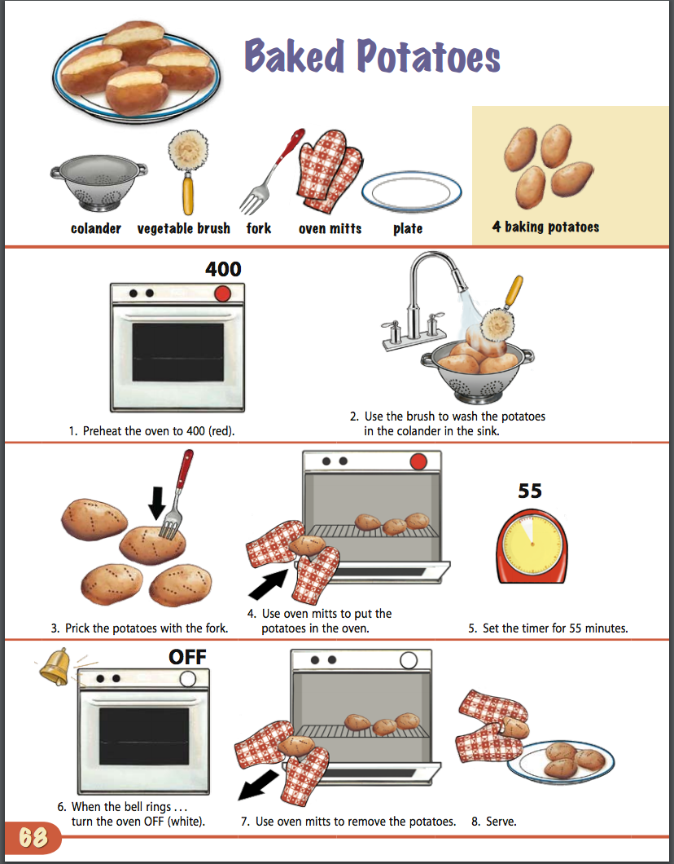
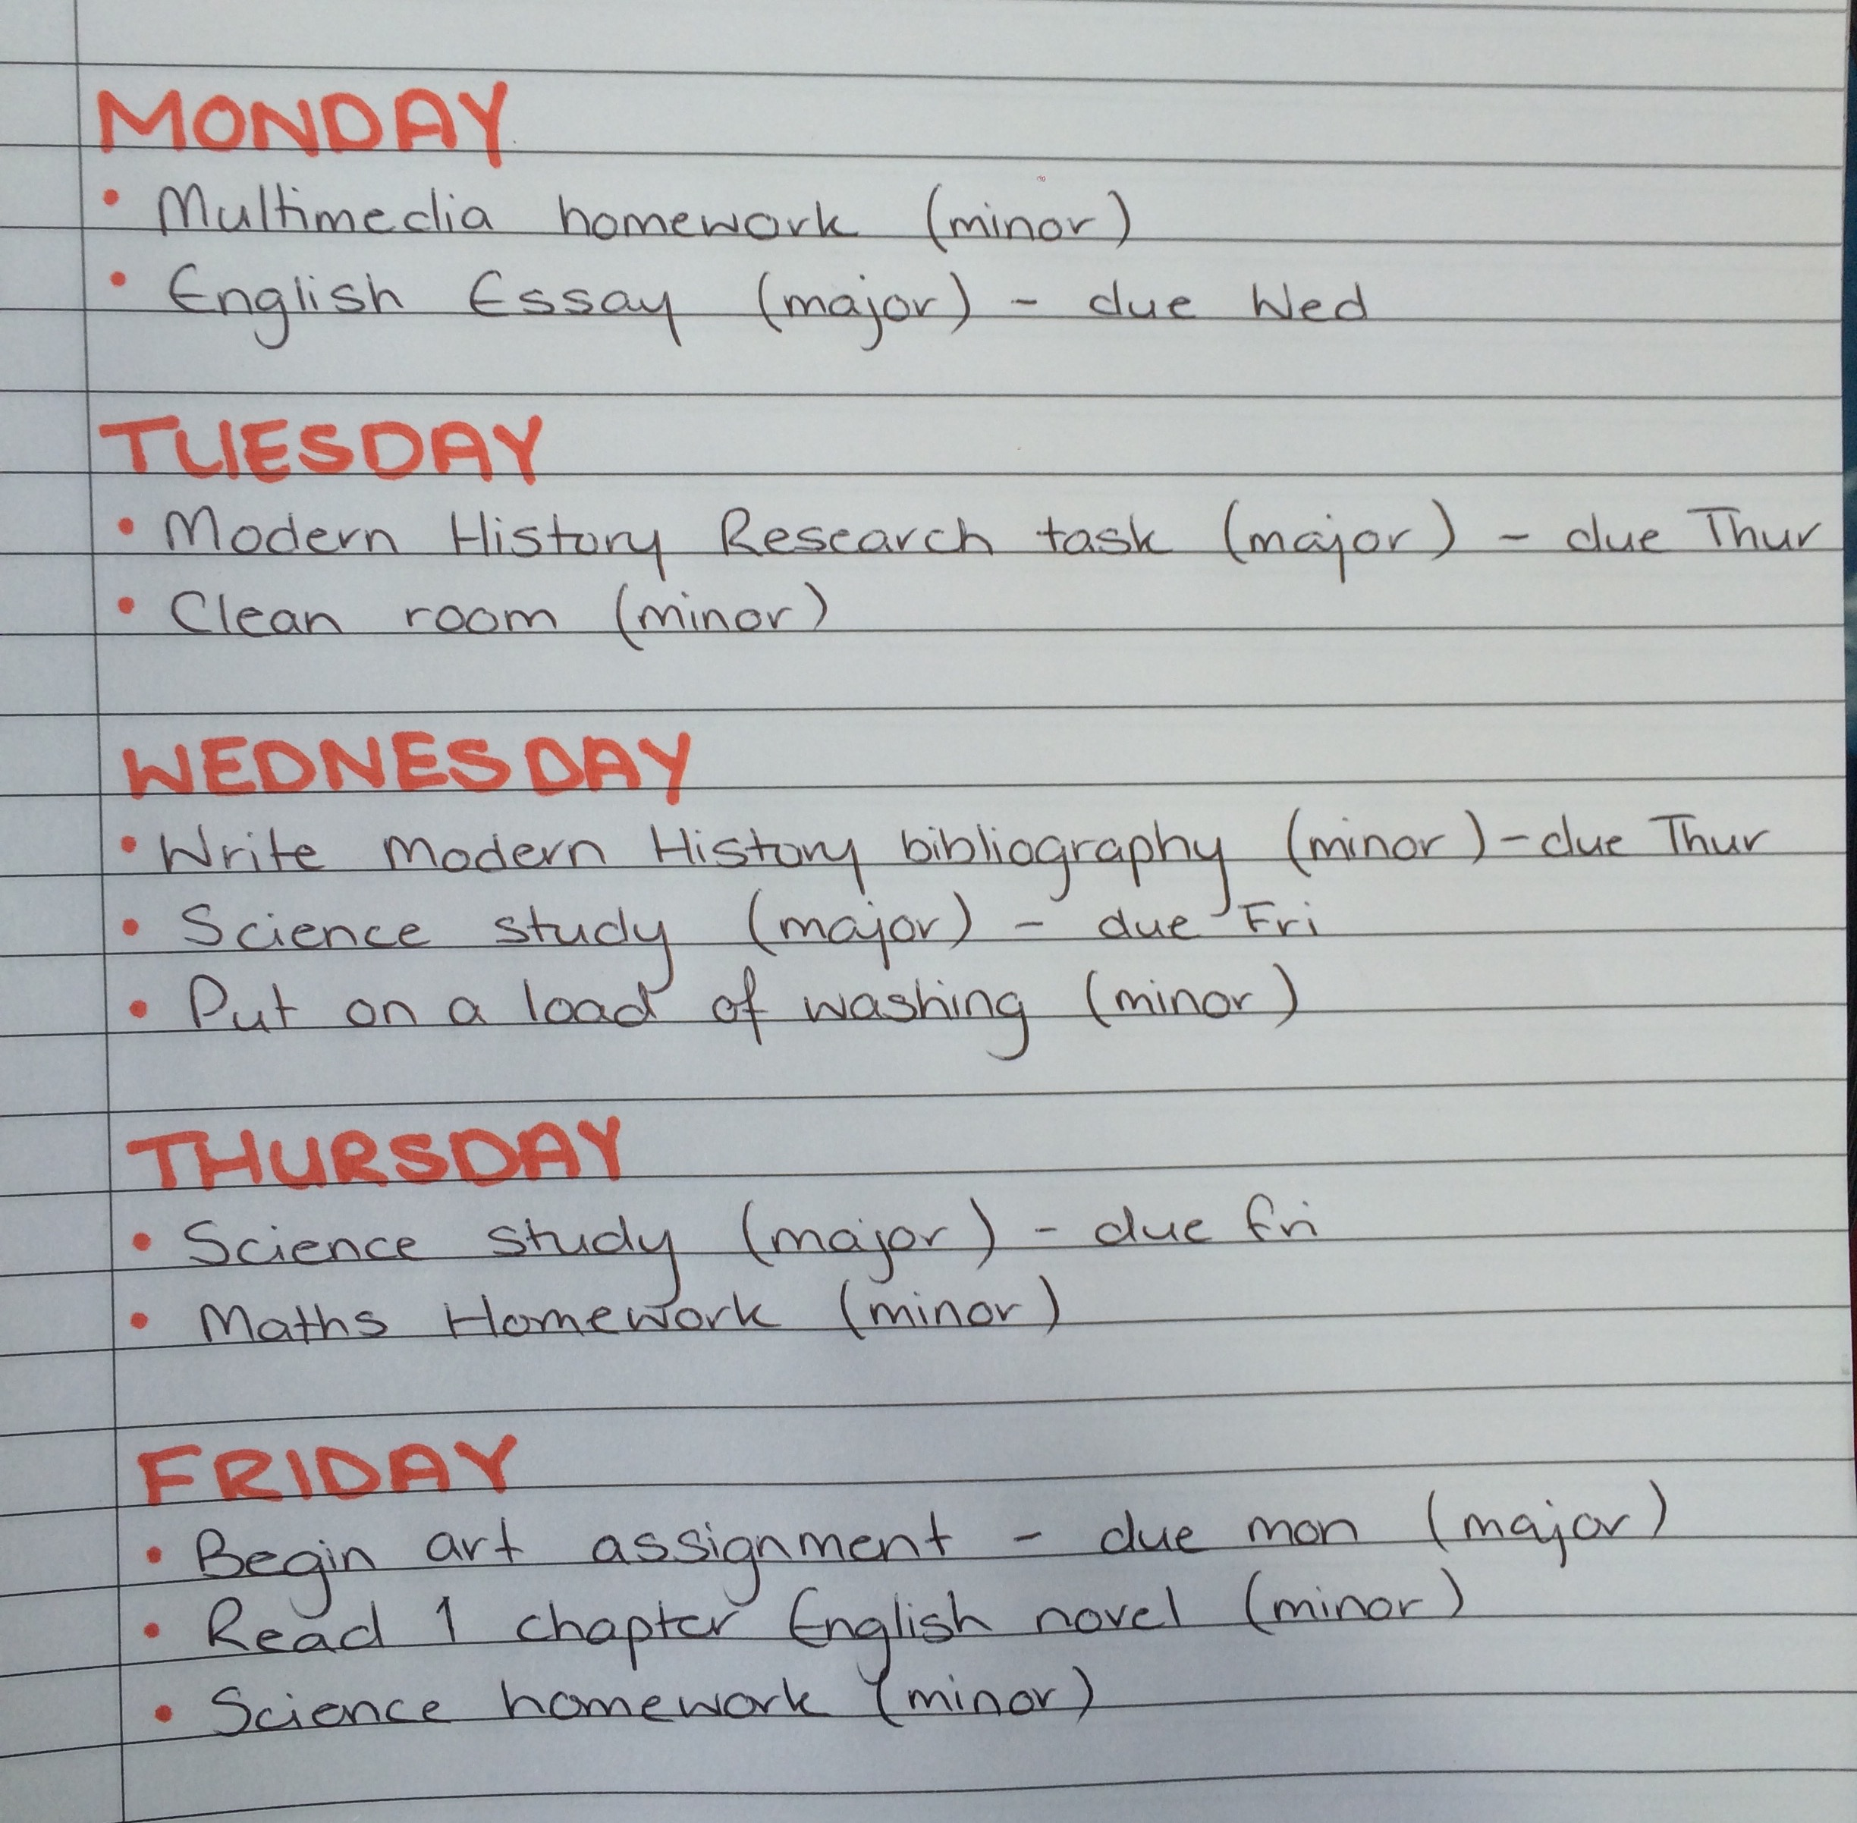
Algorithm
In a non-technical setting we use algorithms every day.
Cooking recipes and to-do lists are good examples of algorithms.

Slide 8
Algorithm
Computer programs are the realization of algorithms on the computer. We also say: a program implements an algorithm.
As programmer, you “tell” the computer:
What to do.
How do to it.
This means you have all the freedom in the world, and are limited by your skills and the capabilities of technology.
Different programmers can write different programs to solve the same problem. Although, some approaches are more efficient than others.

Slide 9
Algorithm (exercise)
Problem:
Assume you have an exchange student coming to visit Hogeschool Rotterdam from abroad. The student will arrive at Schiphol Airport and needs instructions how to get to HR (Museumpark).
Task:
Write an algorithm to help the student travel from Schiphol Airport to Hogeschool Rotterdam.
Work in teams (2-3 students)
10 minutes.

Slide 10
Algorithm (exercise – solutions)
Taxi algorithm
Go to the taxi stand.
Get in the taxi.
Give the driver HR address.
Pick-you-up algorithm:
After clearing passport check, call us on +31-6-XXXX-XXXX
Go to the information booth.
Wait for us there.

Slide 11
Algorithm (exercise – solutions)
Public transport algorithm
Go to the train station.
Get the ticket.
Get into train to Rotterdam.
Switch to metro (blue lane).
Exit at Beurs station.
Walk west until you encounter the building at Museumpark.

Slide 12
Algorithm representation and algorithm types

Slide 13
Algorithm representation
There are numerous ways to describe / write an algorithm.
Some are more formal (e.g. pseudocode) and some less (e.g. natural language).
Flowcharts – block diagrams are among the most used to describe an algorithm.

Slide 14
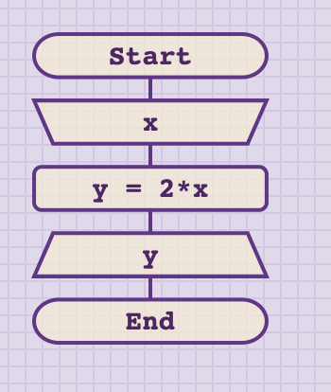
Flowchart

Slide 15
Flowchart
input
start and end points
processing
output
Notes:
Note: explain these shapes to students. They should be able to differentiate between input / processing / output steps.
Also, you can mention that a lot of “western literature” uses the same symbol for both input and output. Any option they choose is fine.
Explain this algorithm in detail:
Input: Assign value to X from user input
Processing: Assign value to Y that is equal to 2*X
Output: print value of Y

Slide 16
Flowchart
What does this algorithm do?
What will it output for given input 1?
What will it output for 2 or 5 or 10?
Can it work if X is not a number? E.g. x = “test”?
Notes:
Note: Go through the steps in detail.
For x = 1 →
y = 2 * x = 2 * 1 = 2
Print y → print 2
For x = 5 →
y = 2 * 5 = 2 * 5 = 10
Print y → print 10
For x = “test” →
y = 2 * test = ERROR !
* This algorithm will not work if x = “test”

Slide 17
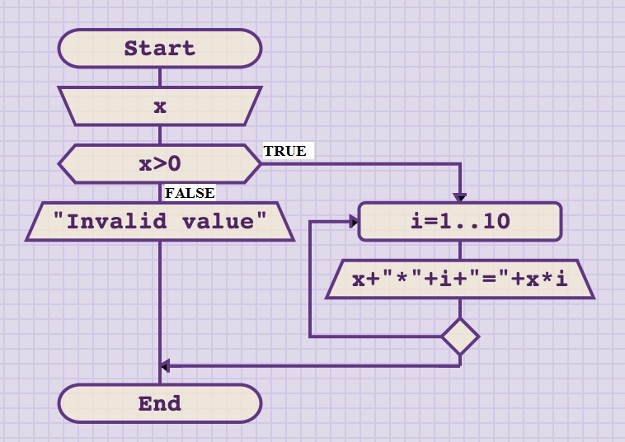
Flowchart
Notes:
Use this slide to illustrate that there are more complex algorithms, but at this lesson we will not be covering them.

Slide 18
Flowchart
branching (if-then-else)
condition
start and end points
input
cycle
FOR loop
outputs
Notes:
Note: most of the concepts (branching, cycles) are not covered yet. They will be introduced later. The point is just to illustrate an algorithm and not go into details. The students should understand that there are algorithms that are not always linear (like the previous example).
You can metion symbols for branching and cycles, but these will be covered in lessons 6 and 8.

Slide 19
Algorithm categorization
As with algorithm representation there are many ways to categorize algorithms.
One of the most known is categorization according to the way the steps are executed.
This categorization divides algorithms into:
Linear
Branching
Cyclic
Essentially, every complex algorithm is a combination of all three of the above.
Notes:
You can mention that these are only base categories and although we will do exercise focusing on these, typical algorithms almost always combine ALL three.

Slide 20
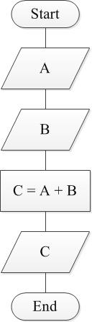
Linear algorithms
Every step is executed once and only once.
Notes:
* You can mention to the students that we used here input/output symbols, but that is not important.
Linear algorithms will be covered in detail in lesson 4.

Slide 21
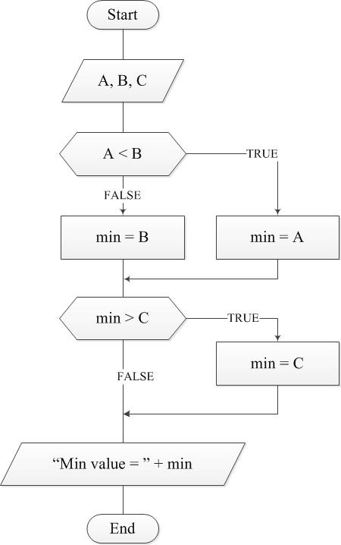
Branching algorithms
Branching algorithms contain steps that will be either executed ONCE or NEVER
Depending on the program logic, some steps will be executed and some will not.
Notes:
Topic of lesson 6.

Slide 22
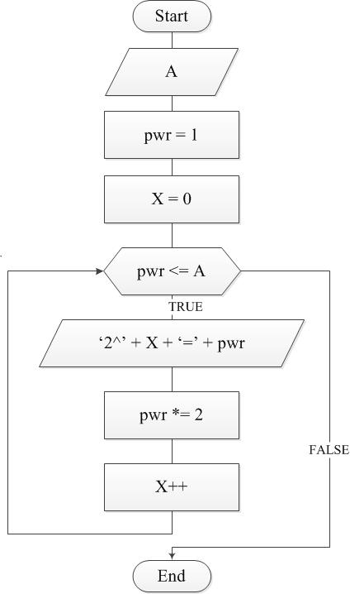
Cyclic algorithms
Algorithms that contain steps that can be executed once or multiple times.
Depending on the program logic, some steps will be executed several times.
Notes:
Topic of lesson 8.

Slide 23
Python
Introduction, installation and “hello world” example

Slide 24

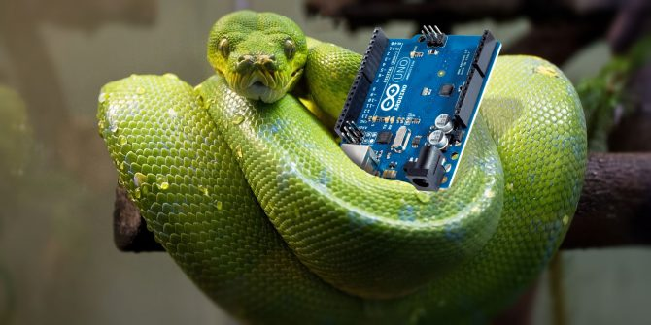
Programming language
Both simple, easy to learn,
… and very advanced.
Interpreted, dynamically typed language.
Focus on programmer productivity rather than machine performance.
Dutch invention, first version around 1989.
Key language in Machine Learning and Data Science
Career advice: Make sure you get to know python well!

Slide 25
Python
Download version 3.8.X from www.python.org .
Install Python.
Start Idle.
There are many good IDEs for Python.
We recommend:
Pyzo (www.pyzo.org) by Almar Klein; lightweight and very intuitive.
Spyder (www.spyder-ide.org) – part of Anaconda package.
Our examples will use Pyzo.
Notes:
IMPORTANT:
If students already have Python installed make sure they can launch IDLE and DO NOT do Python installation!!!
Ask if they used Ana(Conda) and then skip this part.
Otherwise, install and setup Pyzo.

Slide 26
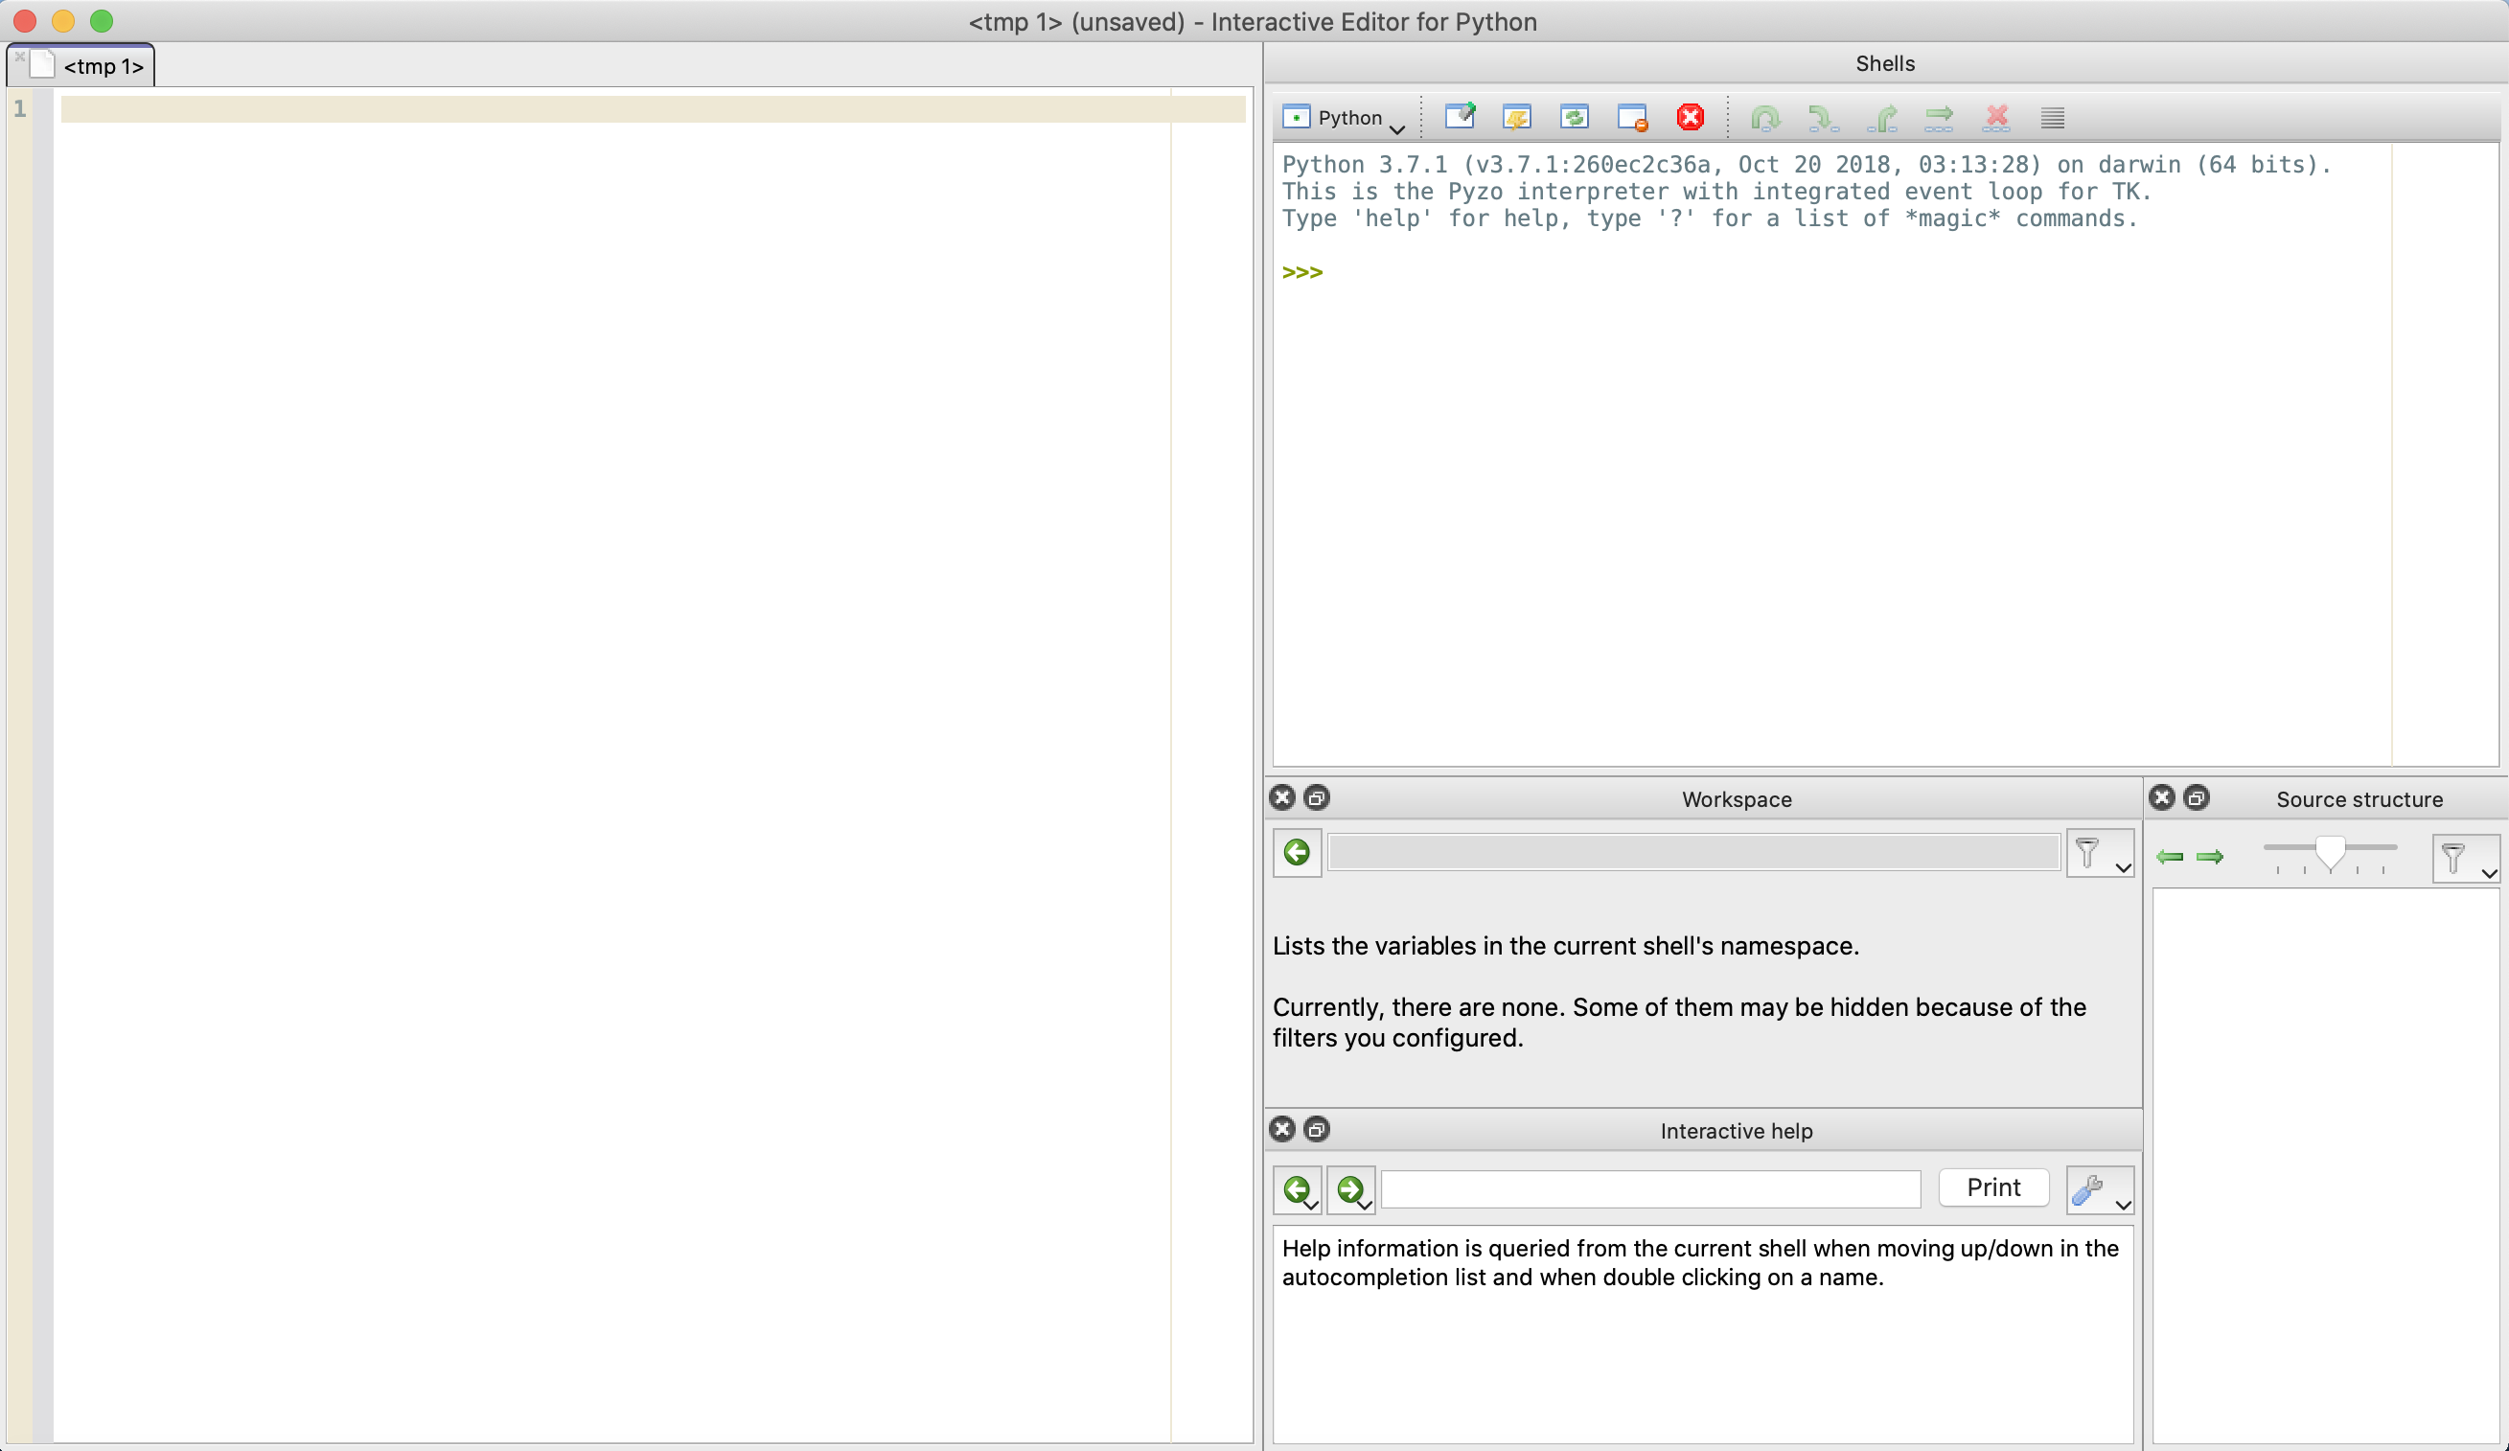
Understanding your IDE
Python shell
File editor
Other windows
Notes:
Note: you can select from Tools wich windows you would like to see. Then rearange them with drage and drop.
This image contains:
Python shell (top right)
File editor (left)
Workspace (middle)
Interactive help (bottom)
Source structure (bottom right)

Slide 27
Python programs
A Python program is a sequence of expressions and commands.
Expressions are evaluated.
Commands are executed by the Python interpreter in a shell.
A command is a statement that instructs the interpreter to perform a specific task.
Commands can be typed directly in a shell, or
Stored in a file, that is later read into the shell and evaluated.

Slide 28
Working with shell
The top line will show the version installed on your computer.
The symbol >>> is a shell prompt indicating that the interpreter is expecting the user to type some Python code into the shell.

Slide 29
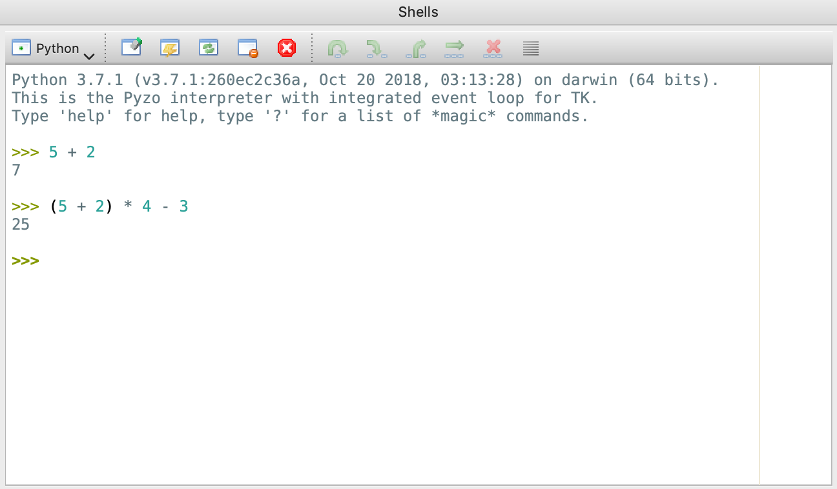
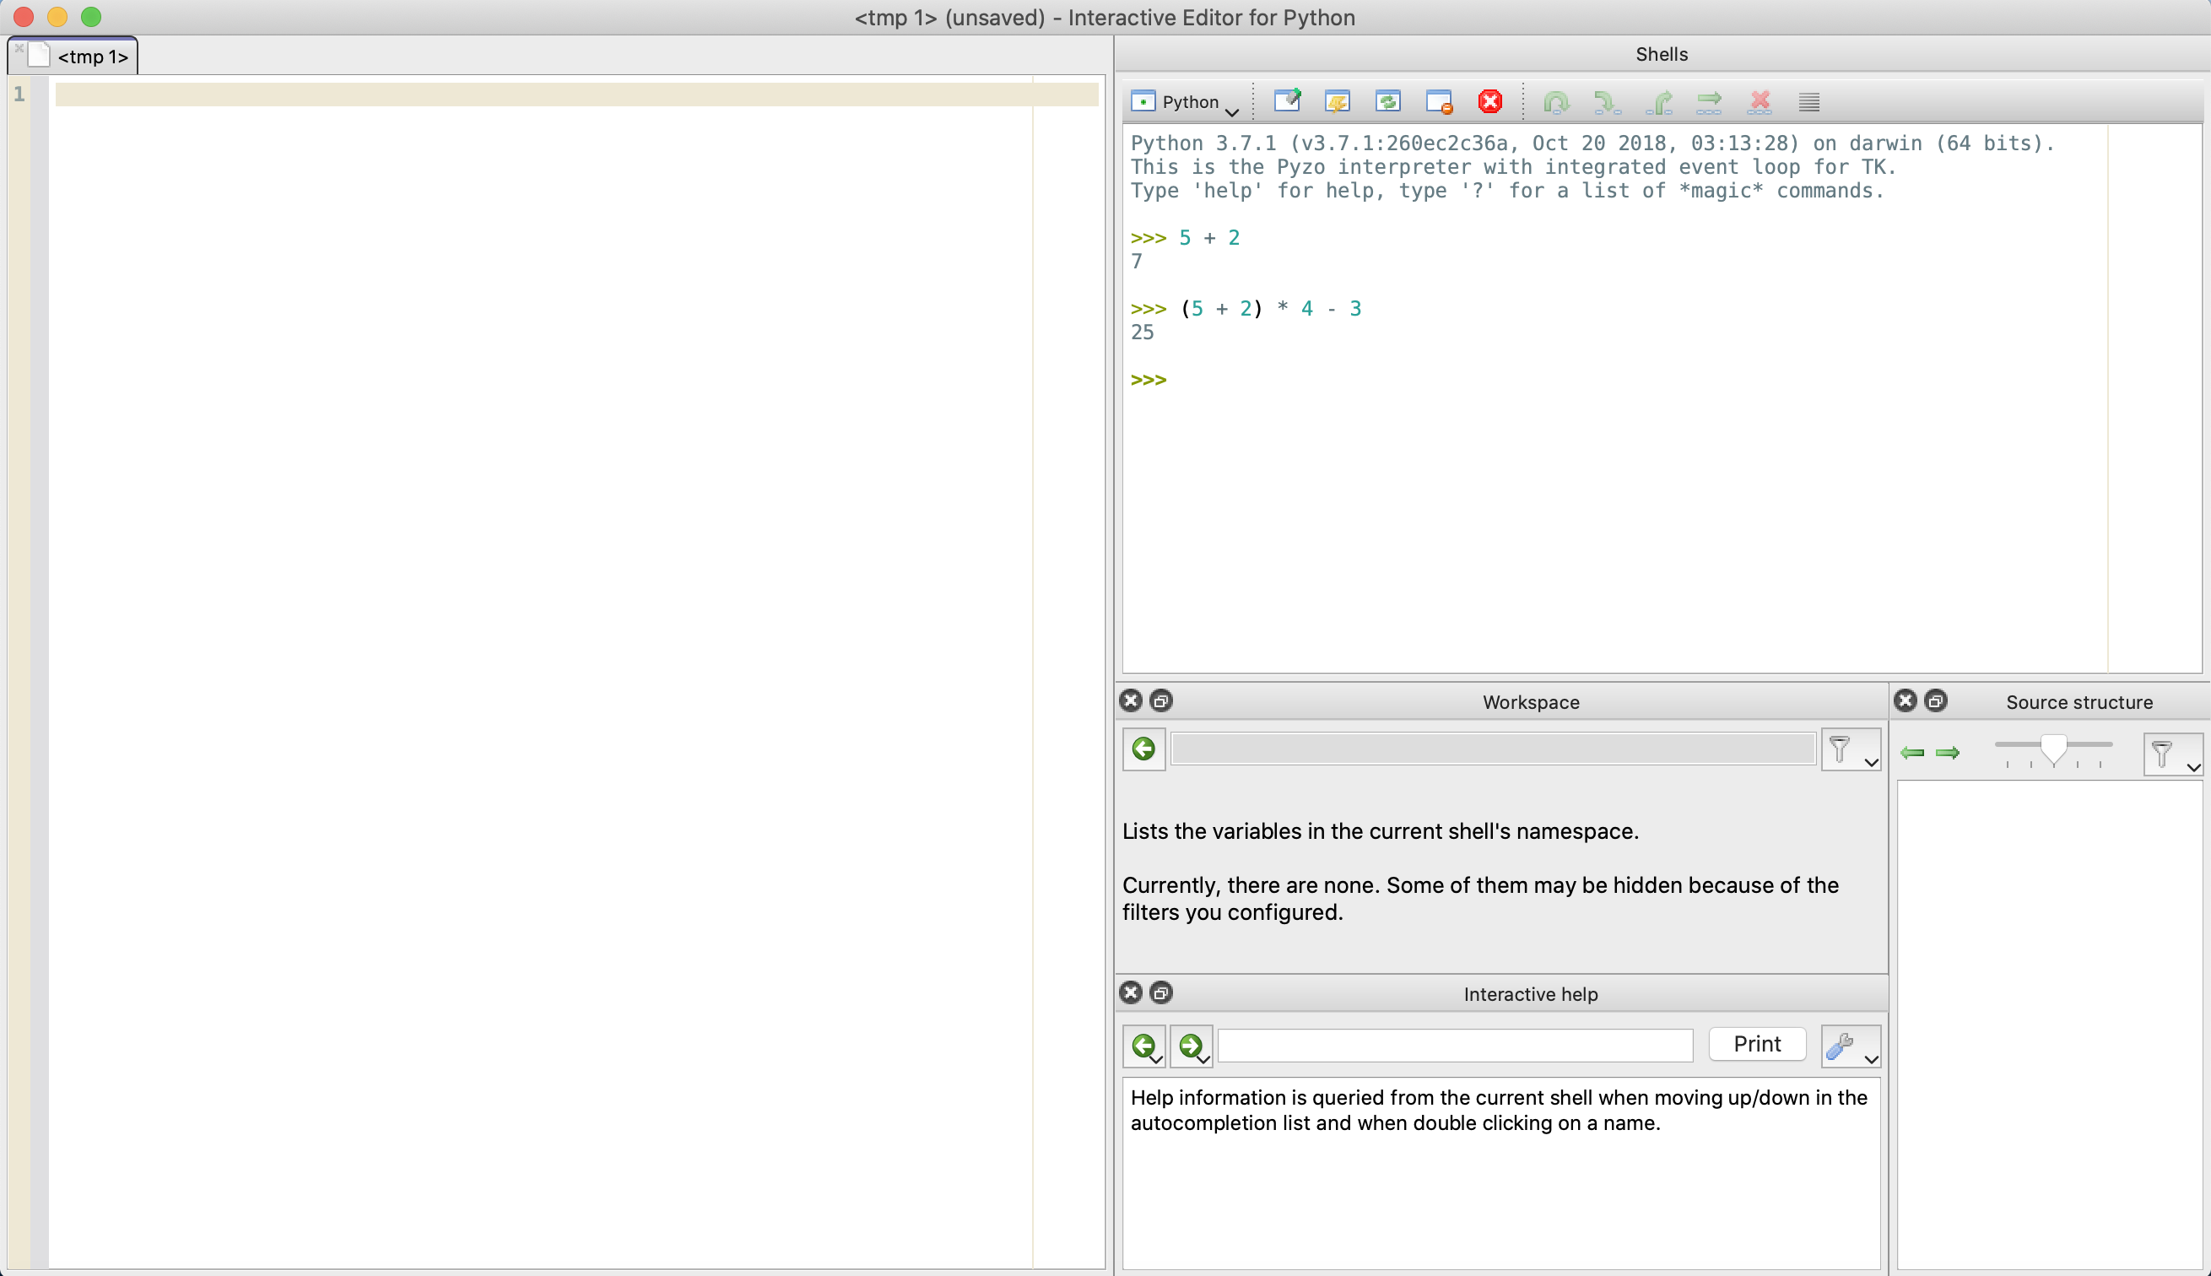
Arithmetic operations in the shell
You can run mathematical operations by typing expressions in shell.
Try typing: 5 + 2 (PRESS ENTER)
What do you get?
Can you calculate: ( 5 + 2 ) * 4 – 3 ?
Use Python to help you.
Experiment with expressions on your own.
Try using negative values.

Slide 30
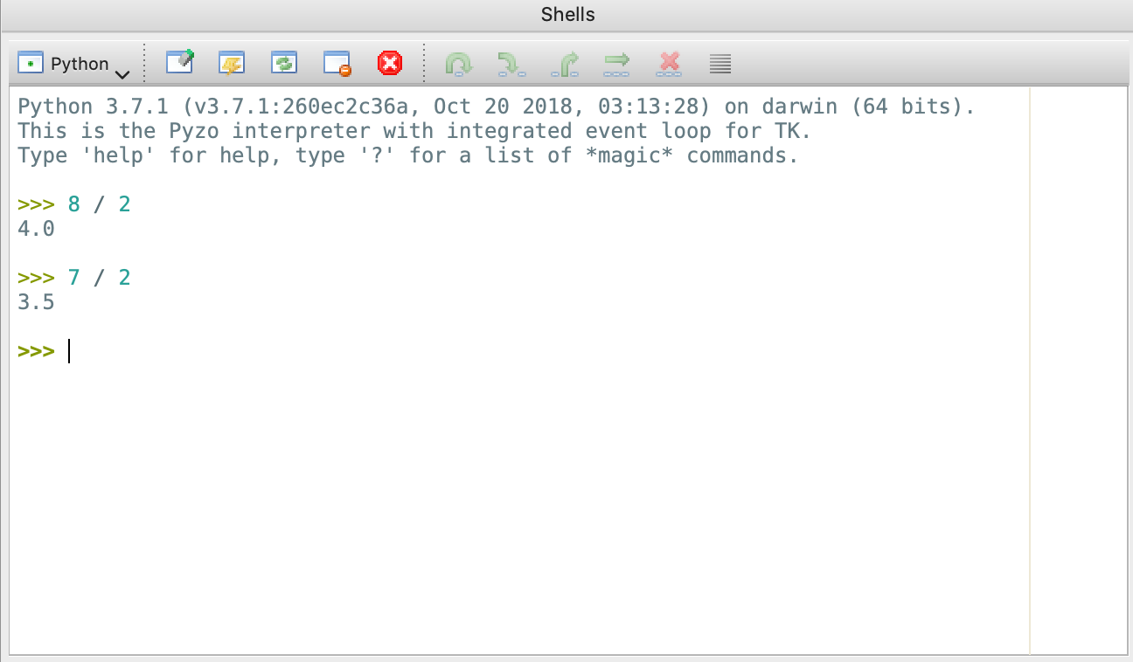
Division (floating point and floor)
Python distinguishes between FLOAT and FLOOR division.
Try: 8 / 2
Then try: 7 / 2
What results did you get?
This was a FLOAT division ( operand / ).

Slide 31
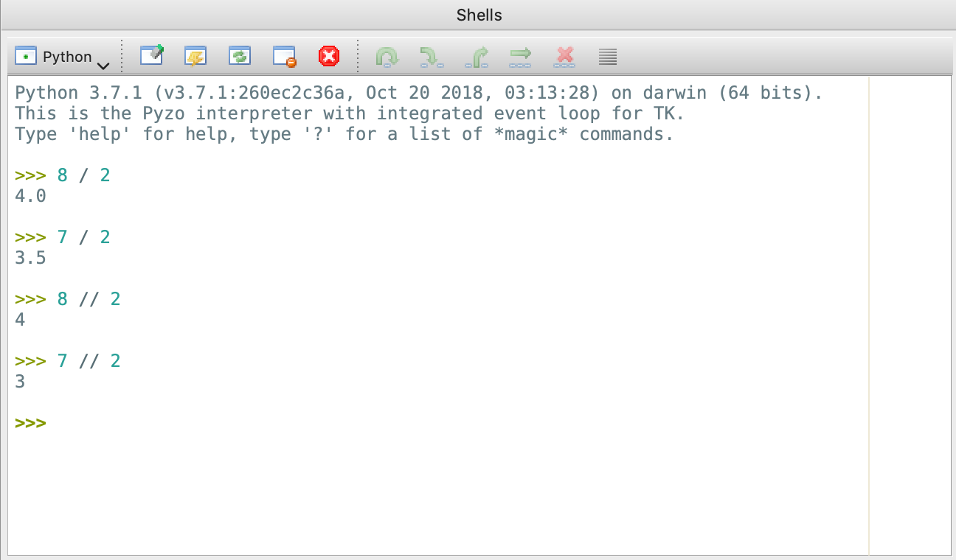
Division (floating point and floor)
Lets try the same values with FLOOR division (operand // )
Type: 8 // 2
Then: 7 // 2
Compare with previous results.
What can you conclude?
* (floor division returns integer (whole number). If result is not an integer, it will round it to the closest lower integer.)

Slide 32
Division (floating point and floor)
Lets try floor division again for 7 and 4.
Type: 7 // 4.
What do you get? Why?
7 // 4 returns 1, because 7 / 4 = 1.75 and if we truncate it to the closest lower integer it will be 1.
So, what happens with the remainder? If we take the result (quotient) and multiply it with divisor, we should get the dividend.
1.75 * 4 = 7
However, since we lost the floating part 1 * 4 = 4 ≠ 7
Therefore, we are missing 7 – 4 = 3. This number (3) is the remainder.
Notes:
Note: please make sure that students understand the difference between float and floor division, as we will rely heavily on those in the following lessons.

Slide 33
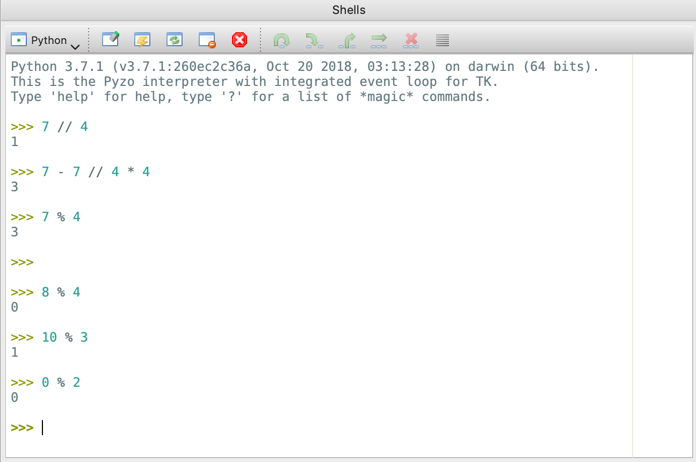
Division (floating point, floor, modulo)
How can we calculate the remainder only?
The “complicated way” is to repeat the same procedure in one line:
7 – 7 // 4 * 4 (result: 3)
But there is an easier way. We can use operand ‘%’ to perform MODULO operation – i.e. return only the remainder.
Try: 7 % 4
Experiment with: 8 % 4, 10 % 3, 0 % 2.

Slide 34
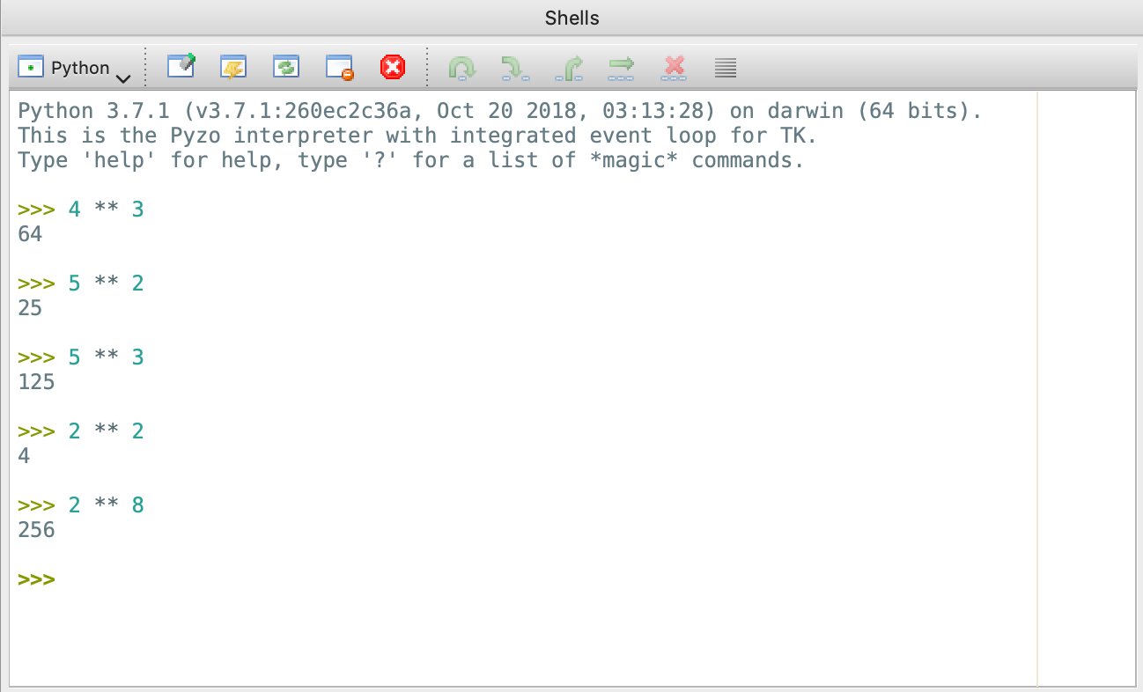
Exponential (power) calculation
To calculate the power,
i.e. 4³ = 4 * 4 * 4 = 64
we use ** operator.
Try: 4 ** 3
Use the knowledge to calculate 5², 5³, 2², 2⁸.

Slide 35
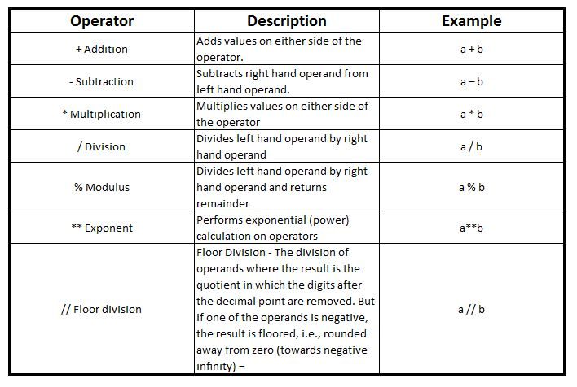
Python operators - recap

Slide 36
Print command
Now that we know how to perform basic mathematic operations, lets introduce our fist command – PRINT.
PRINT is a very powerful Python command with many options, but we are going to use the very basic for the start. We will use it to print some text to the standard output – in our case: screen.
NOTE: the syntax for PRINT command is different for Python 2.X and 3.X. Here we assume that everyone is using version 3+.
Example:
print(“text-we-want-to-display”)

Slide 37
Print command
Finally, we just type text (any text) we
want to display. This is the only part
Python doesn’t have to understand.
Lets take a closer look:
print(“text-we-want-to-display”)
We start by using print to display text only.
To tell Python we are using text we must start with
quotes and end with quotes. You can use either
single ‘ or double “ quotes, but you cannot interchange.
Print is a function and as such must begin and end with parenthesis ().
For now just remember that after keyword print you must use ( and at the end
you must use ).
This is the keyword that tells Python which command we want to use.
Notes:
We will not tackle functions yet. Just make sure that the syntax is memorized by heart at this stage.

Slide 38
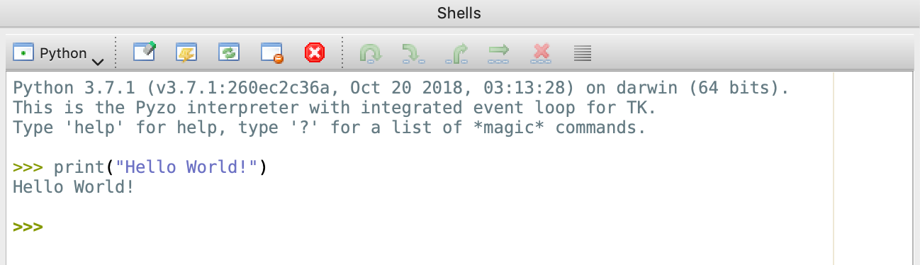
Hello World
It is a common practice to get introduced to the new programming language by shouting HELLO WORLD, and we won’t be the exception.
So … try using PRINT command to output “HELLO WORLD!”.

Slide 39
Program file(s)
So far we have seen how to run basic commands in shell.
As programs get bigger, this will prove very impractical.
Therefore, lets create our first program file and make it output “HELLO WORLD.”
Notes:
You can let students use any other IDE if they have installed.
The students must be able to load and run Python file after this lesson.

Slide 40
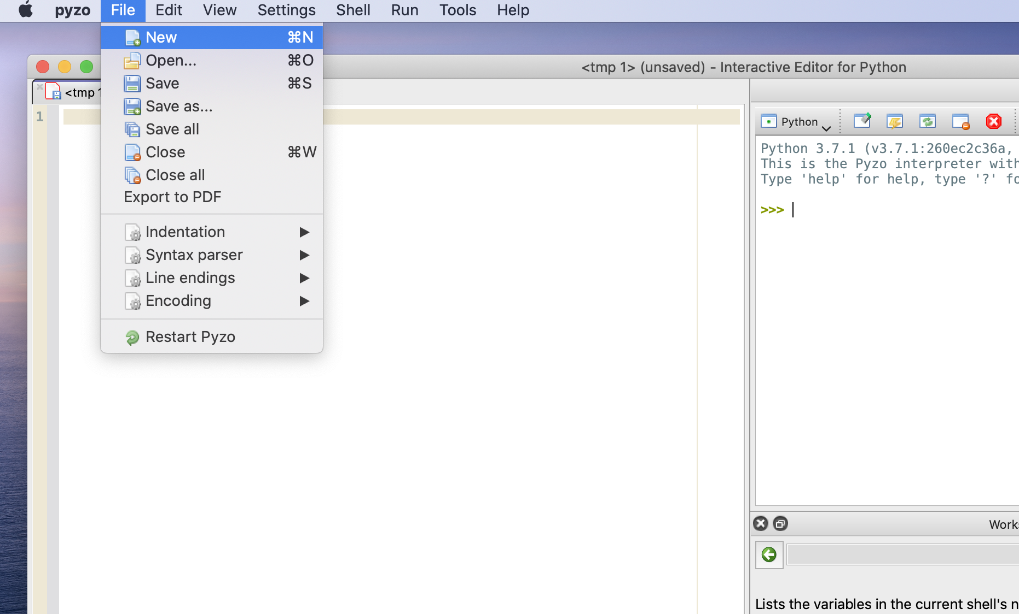
Program file(s)
Upon the first start, Pyzo will create an empty file space called <tmp 1>
To add a new file, from the menu select File → New File (or Ctrl + N).
A new file and the tab will be added.
Type your command:
print(“Hello World!”)
Choose File → Save or File → Save as, select path on your computer and chose a name.
Normally, Python programs have .py extension.

Slide 41
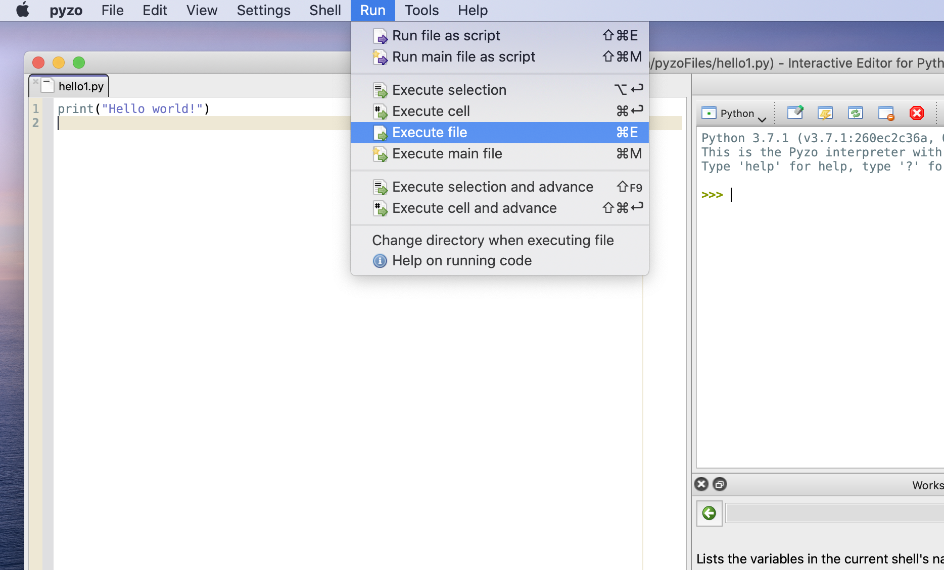
Program file(s)
To run (execute) file select Run → Execute File. The shortcut is F5. (Mac users use FN + F5).
Congratulations!
You have written and executed your first program in Python.
Feel free to experiment by adding more lines of text.
You can load the saved file later by selecting File → Open.

Slide 42
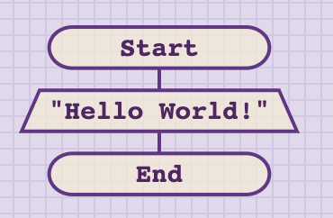
Exercise
Apply what you have learned about algorithms.
Create a flowchart – block diagram for the Hello World program you just made.
Use pen & paper.
Time: 3 minutes.
solution:

Slide 43
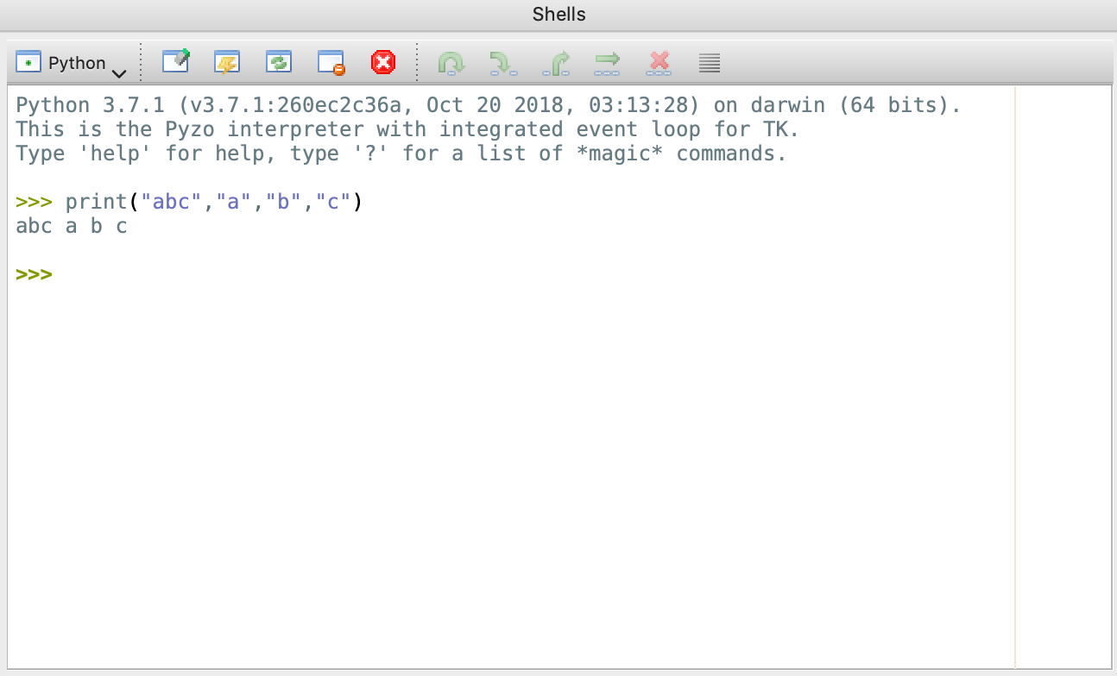
More about print command
Print command is very versatile.
If you want to print multiple strings, you can separate them with comma(s) ‘,’.
Note that when you use ‘,’, Python will add space by default.
Try (in shell or in file and then run it): print("abc","a","b","c")

Slide 44
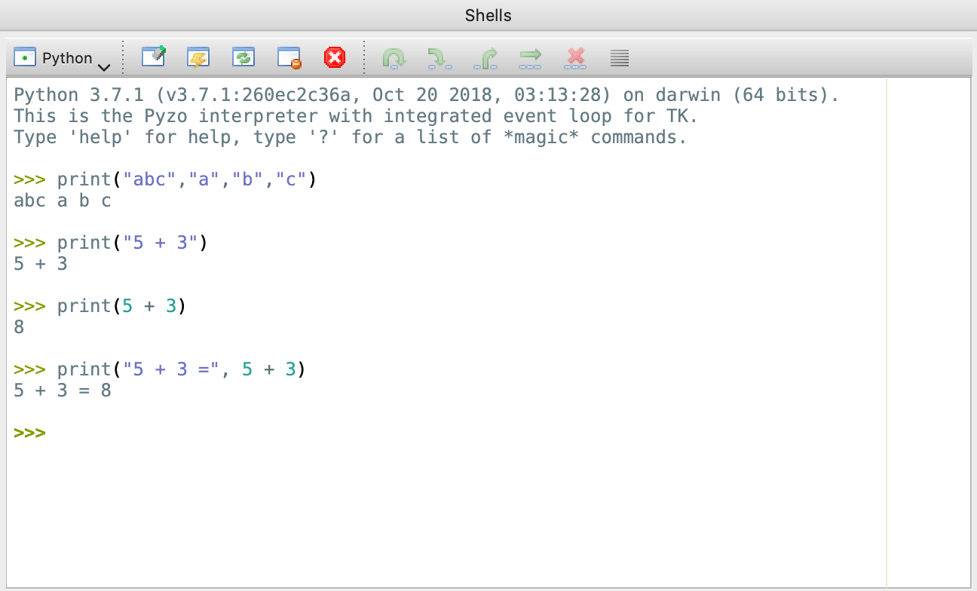
More about print command
Print command will print to the standard output (console by default) everything between quotes.
You can use both single or double quotes (”text” ‘text’), but don’t mix.
To print the result of an expression, write it in print command without quotes.
Try print("5 + 3") and print(5 + 3)
Also try: print("5 + 3 =", 5 + 3)

Slide 45
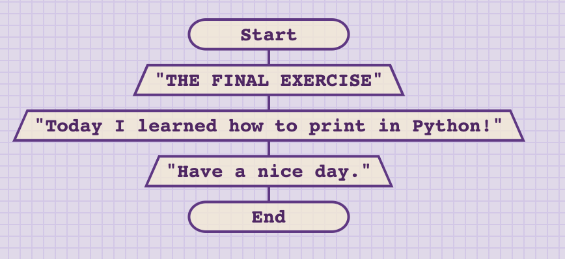
Exercise 2 - measuring learning objectives
Implement (write) a Python program according to the given linear algorithm.

Slide 46
Summary Quiz
What is an algorithm?
Can you give an example of algorithm in non-technical world?
What are computer programs?
How can we represent algorithms?
How do we categorize algorithms according to the way the steps are executed?
Which Python operators do you know?
What operators did we use for division?

Slide 47
Summary
An algorithm is a step by step method of solving a problem in finite number of steps.
Cooking recipe, to-do list are some of the examples of using algorithms in non-technical world.
Computer programs are the realization of algorithms on the computer. Programmers “tell” the computer what to do and how to do it.
There are many ways to represent an algorithm. Some or more and some less formal. Flowcharts are among the most used.
According to the way the steps are executed, we categorize the algorithms into: linear, branching, cyclic. Typical algorithms are combination of all three.
In this lesson we covered basic mathematical operators for addition (+), subtraction (-) multiplication (*), power (**) and division operators.
For division we used float division(/), floor division (//) and modulo (%).

